Slide 1

Modern development tools
Business Central Wave 1 2021

Slide 2
Improvements
Adding keys to base tables and table extension tables
Use of one-dimensional barcode in reports
Extension validation on upgrade
Interface – obsolete support
Report extensibility
Return of record link instead of name on lookups
Additional dimensions in Item Tracking
Improved extensibility of reservation management
New AL objects: Entitlements, permissionSet and PermissionSetExtension
Return of complex types

Slide 3
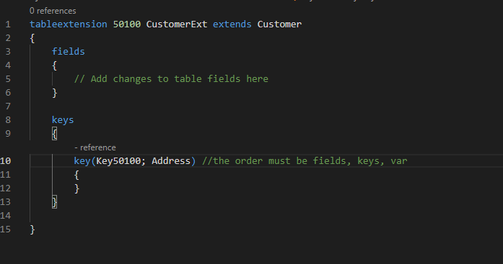
Adding keys
Adding index through an table extension
Enable / Disable keys
For MS SaaS: Go to Tenant Admin Center and you can find a list of existing keys
For 4PS Cloud / Onpremise: Through PowerShell: SetBCKey [-ServerInstance] <String> -KeyName <String> -Enable –Disable GetBCKey [-ServerInstance] <String> [-KeyName <String>]

Slide 4
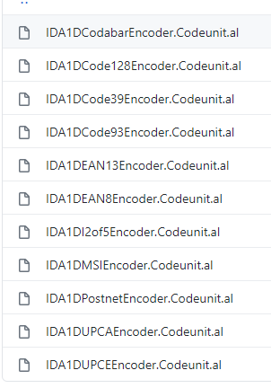
One dimension Barcode reports in BC
Only for Business Central Online because of license.
Module in de System app: ALAppExtensions/Modules/System/Barcode/src at master · microsoft/ALAppExtensions (github.com)
For development:
Use the demo versions and install as a font.
Docker -> use Add-FontsToNavContainer

Slide 5
Extension validation
This is only for PTE extensions
Check of dependencies are provided
That the code compiles
No breaking schema changes
No duplicate ID

Slide 6
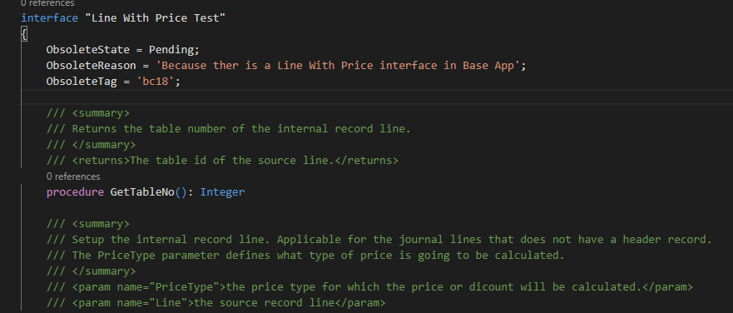
Interface - Obsolete
Now the object Interface can also be put on obsolete

Slide 7
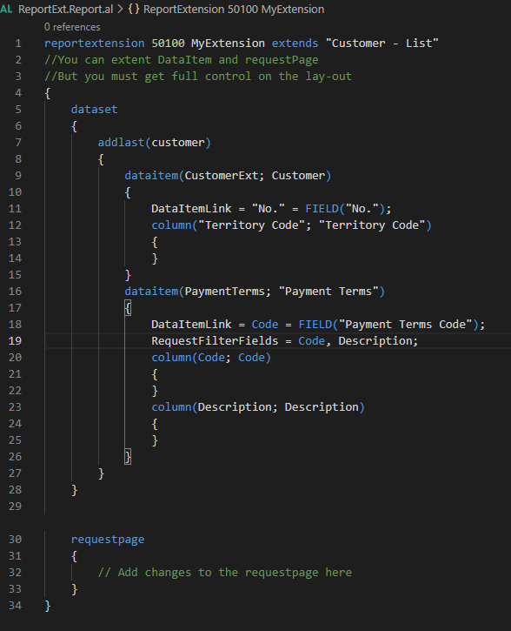
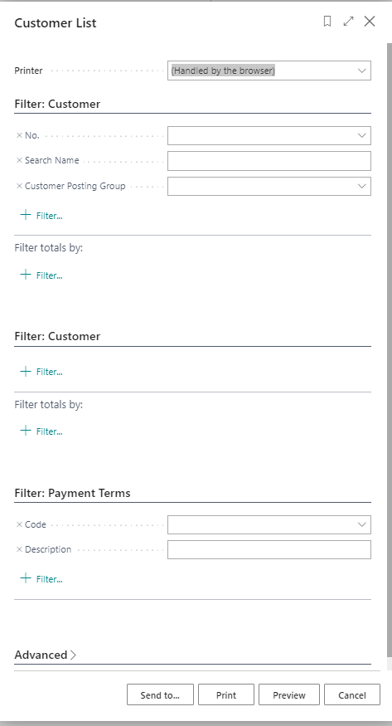
Report extensibility
Extend reports for dataitem and request page
Lay-out extension? -> You must create a new layout for it in your extension

Slide 8
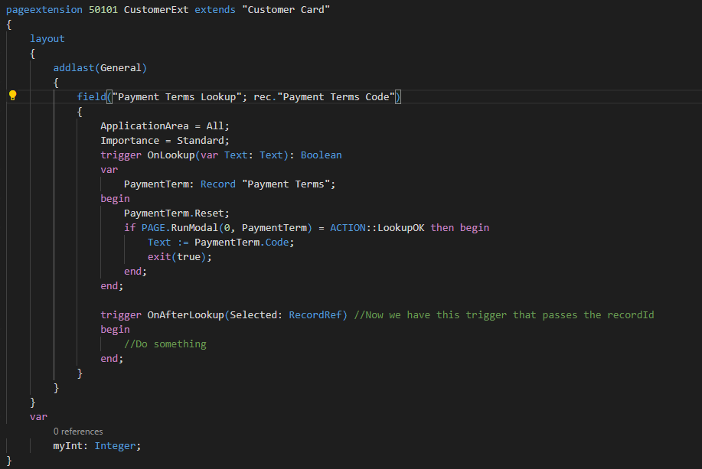
Record link when using lookups
Now next to the name you can get also the recordID

Slide 9
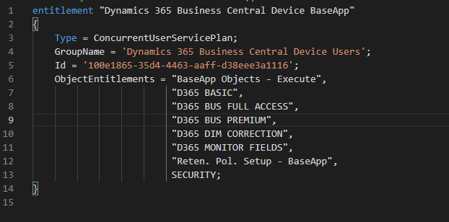
New AL objects
Entitlements
In your extension you can put what kind of permissions the user is needed.

Slide 10
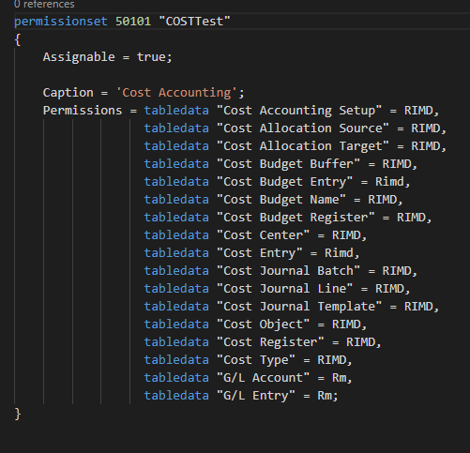
New AL objects
PermissionSet

Slide 11
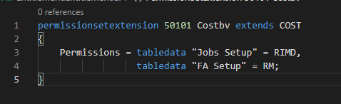
New AL objects
PermissionSetExtension

Slide 12
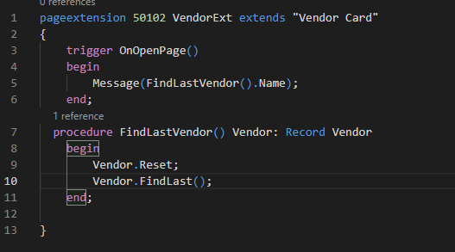
Return of complex types
You can return now complex types like:
Record
List and dictionary
HttpResponseMessage
Codeunit, Qeury, Report, Page, XMLPort

